Slide 1
BTECH
Re-Design

Slide 2
Site Summary – Approximately 25 Pages
Home Page
BTECH News
Academics
About
About BTECH
BTECH Core Values
SAP & BTECH
BTECH Video
Important Links
Calendar
Parents
PTA
Parent Coordinator
Parent Links
More
Students
BTECH Cell Phone Policy
Clubs
Graduation Requirements
Purchasing Shirts for PE
Student Government
Student Handbook
Multimedia
BTECH Videos
BTECH End of Year Bash 2016
GE Skills Lab – Simulation at SAP
Network Groups
Life at BTECH
Science Class
Thanksgiving Fit and Feast 2015
Login

Slide 3
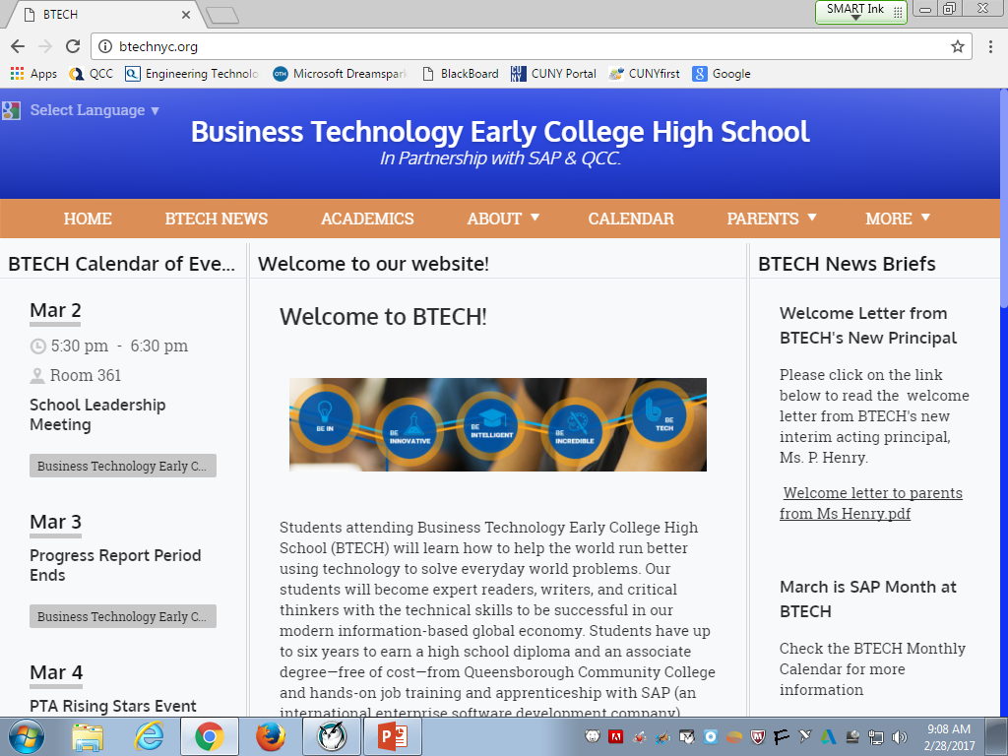
Home Page

Slide 4
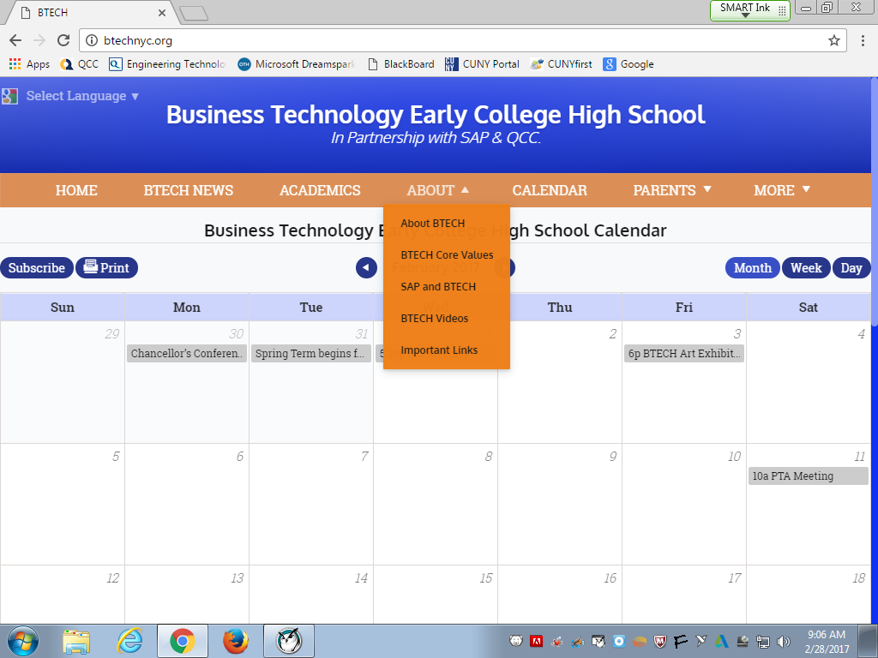
About Drop-Down Menu

Slide 5
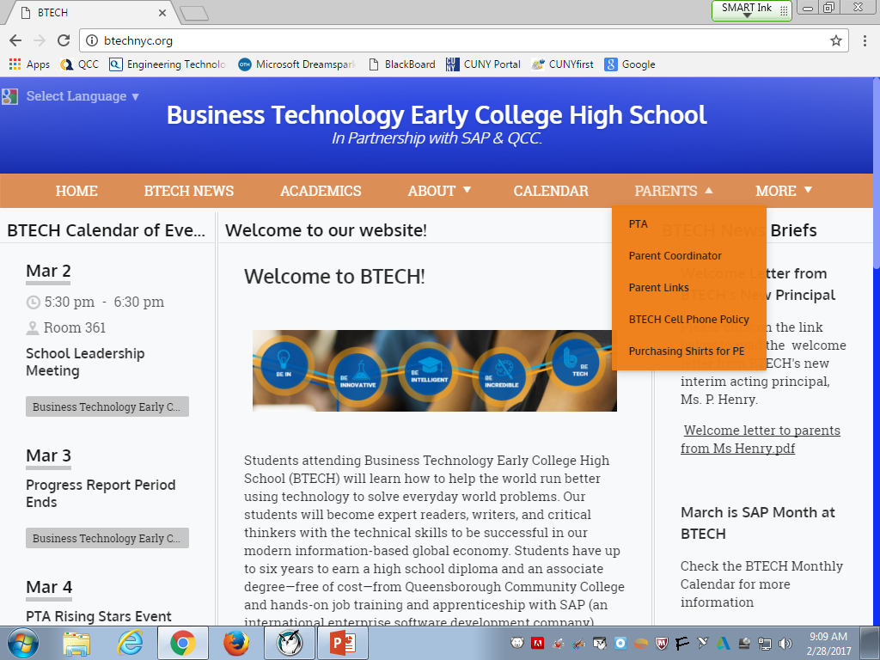
Parents Drop-Down Menu

Slide 6
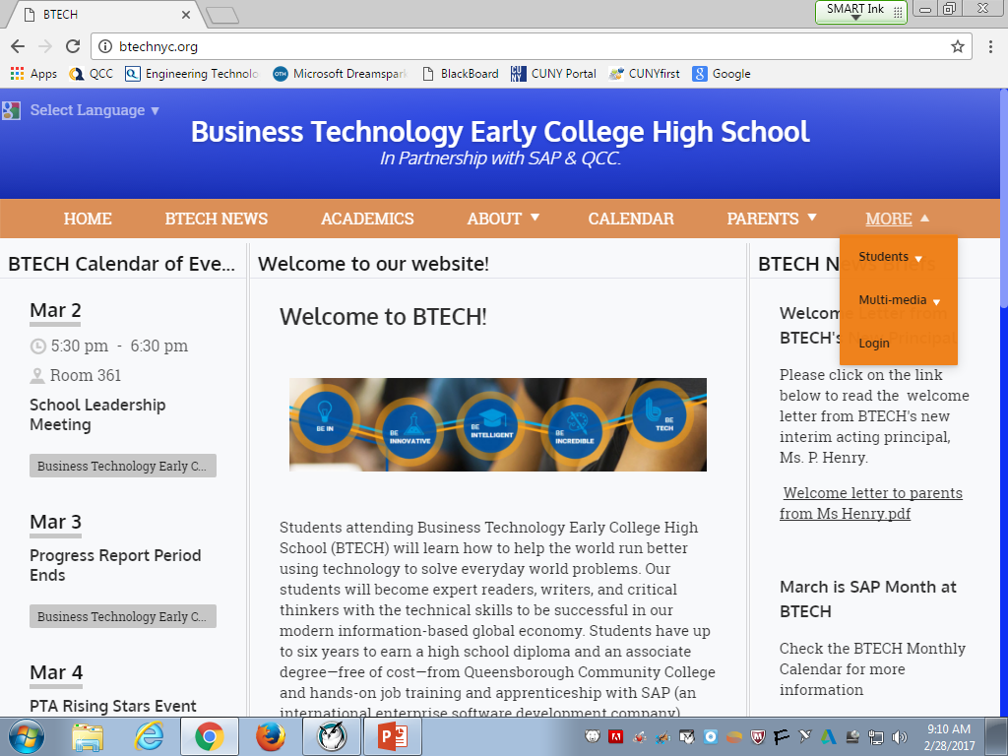
More Drop-Down Menu

Slide 7
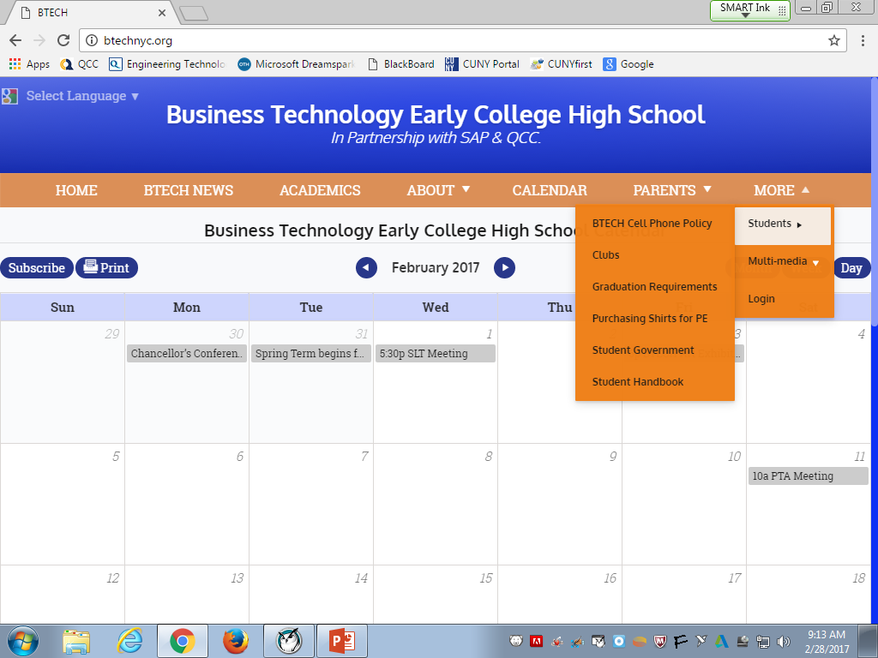
Students Drop-Down

Slide 8
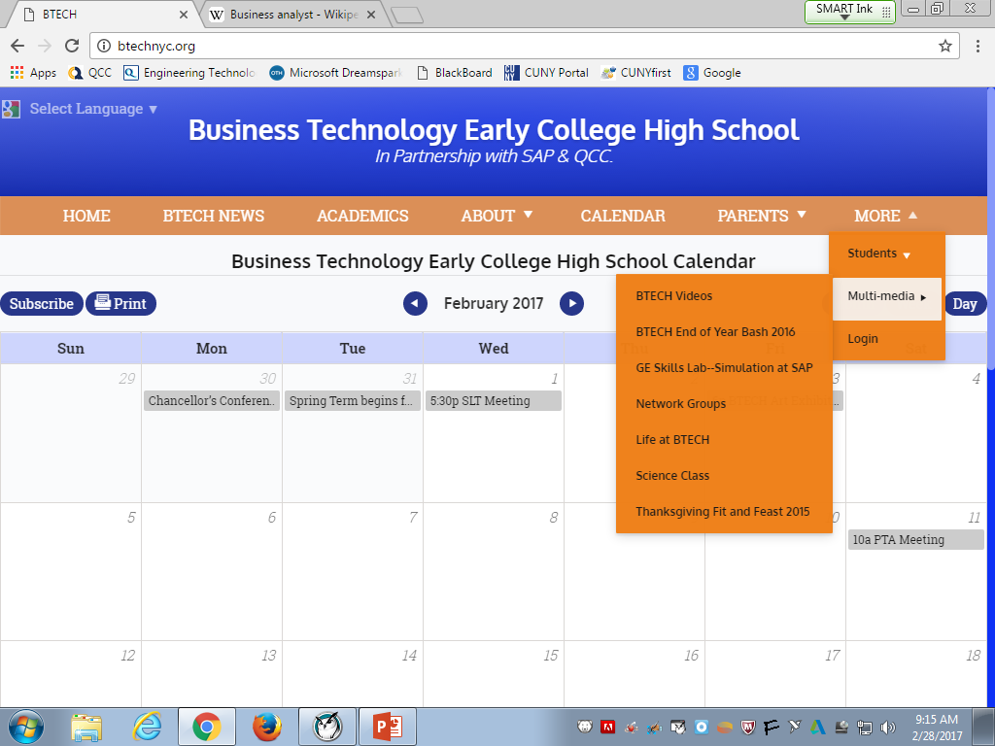
Multimedia Drop-Down Menu

